Slide 1
Atomic structure-1
18/07/2023
Dr. Muhammed Shah Miran
Professor, Department of Chemistry
University of Dhaka, Dhaka 1000

Slide 2
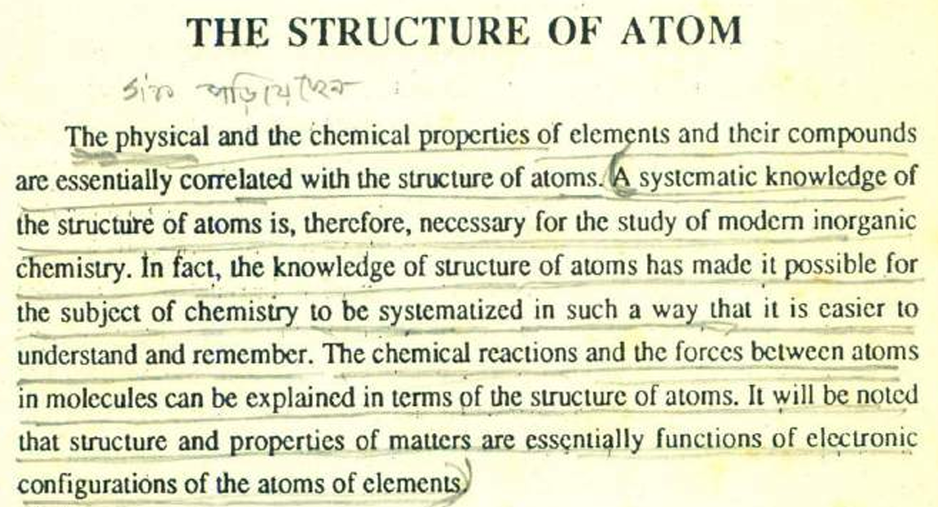
Importance of the structure of atom

Slide 3
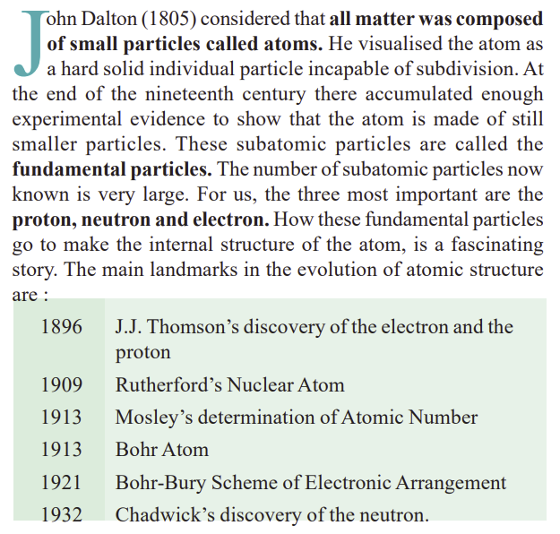

Slide 4
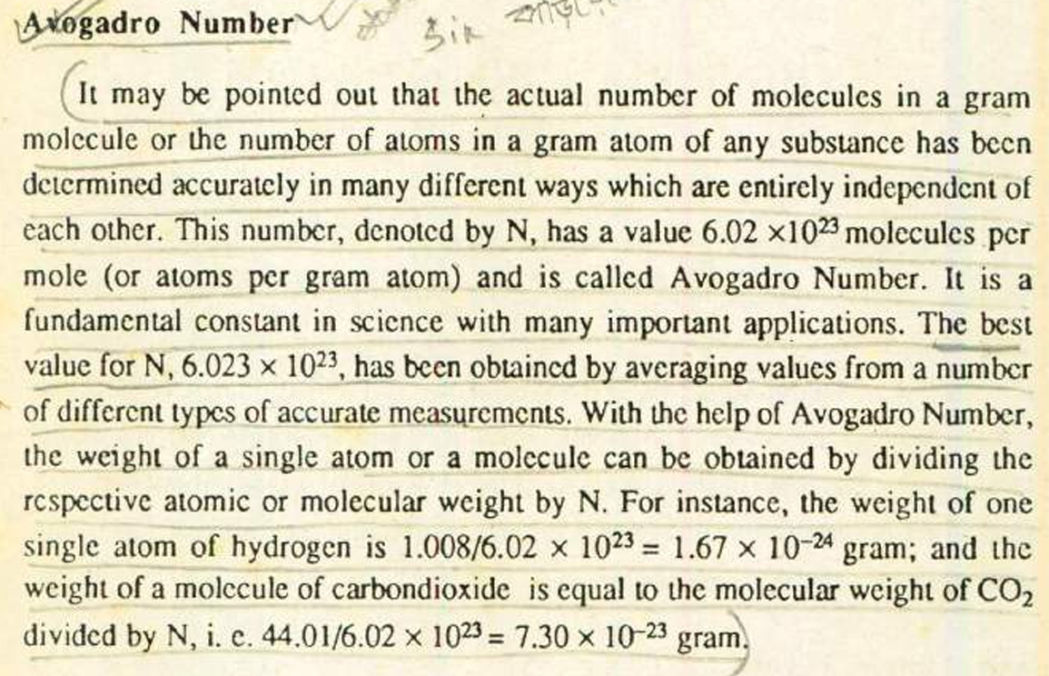

Slide 5
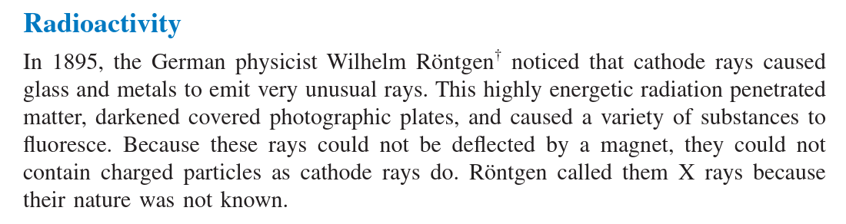

Slide 6
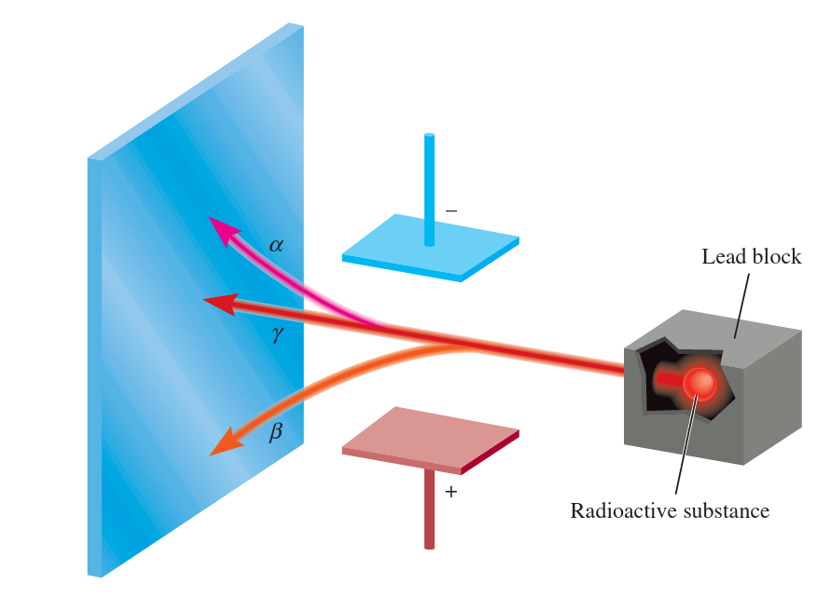
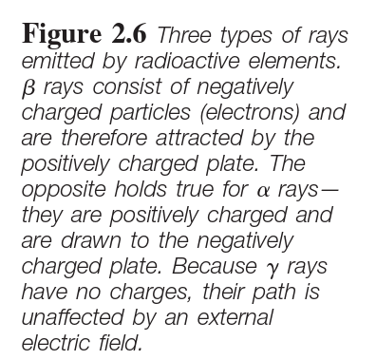

Slide 7
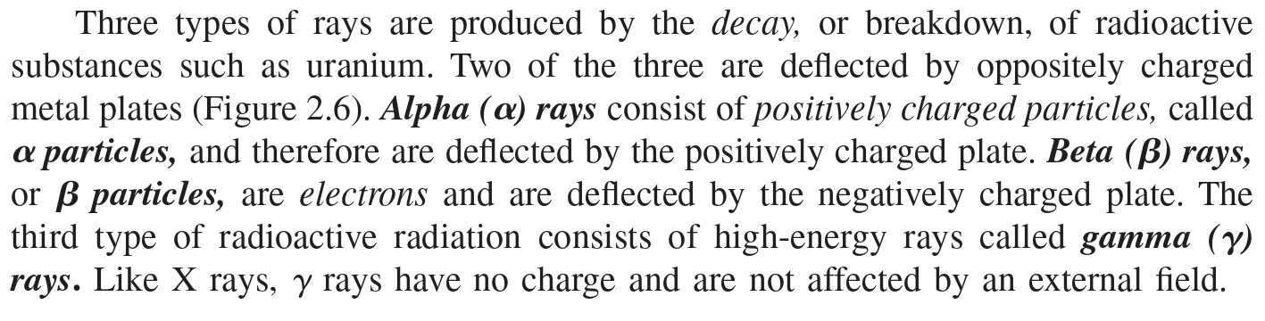
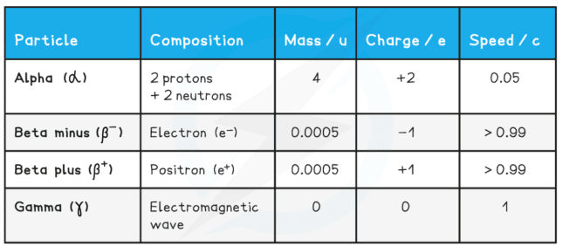

Slide 8
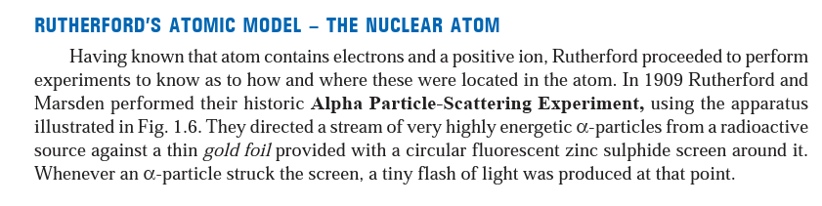

Slide 9
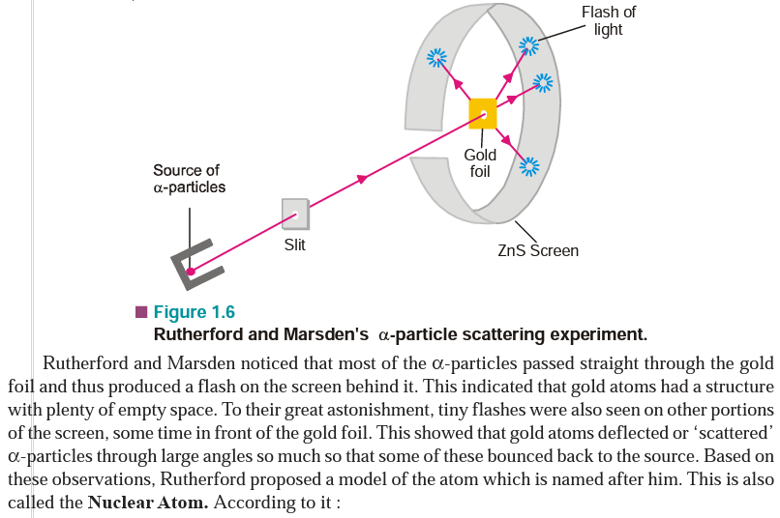

Slide 10
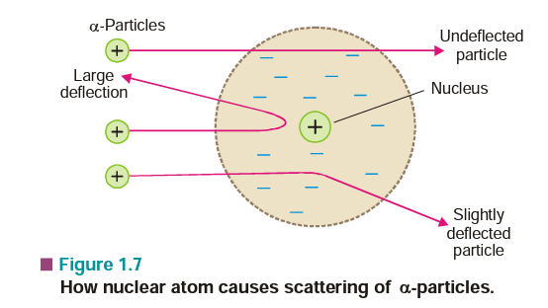

Slide 11
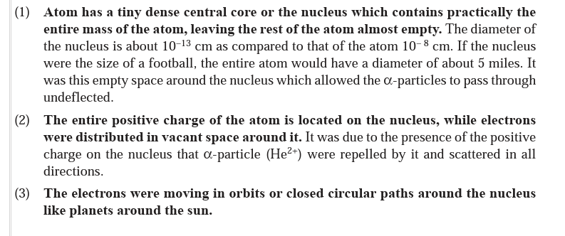

Slide 12
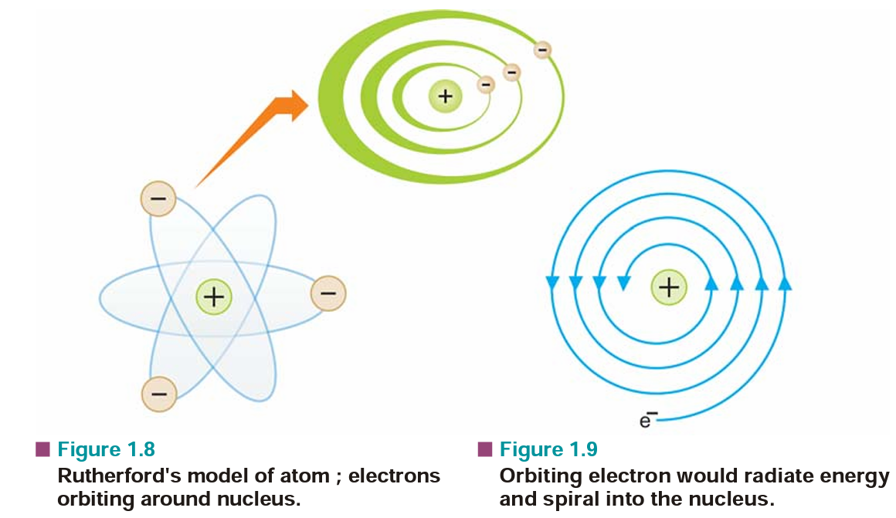

Slide 13
Weakness of Rutherford Atomic Model
The assumption that electrons were orbiting around the nucleus was unfortunate. According to the classical electromagnetic theory if a charged particle accelerates around an oppositely charged particle, the former will radiate energy. If an electron radiates energy, its speed will decrease and it will go into spiral motion, finally falling into the nucleus. This does not happen actually as then the atom would be unstable which it is not. This was the chief weakness of Rutherford’s Atomic Model

Slide 14
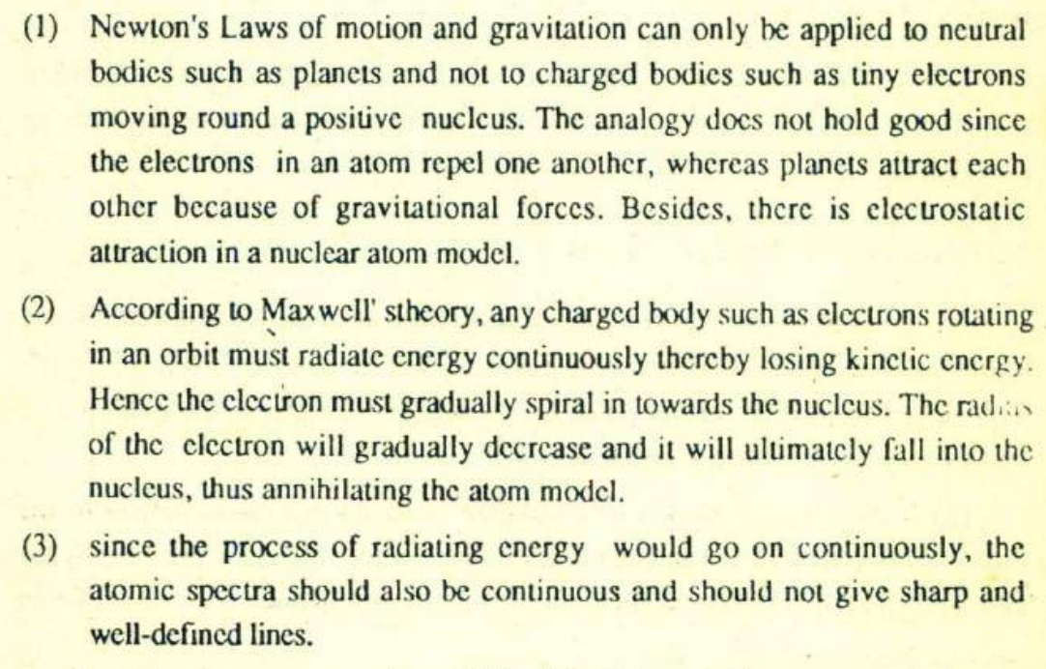

Slide 15
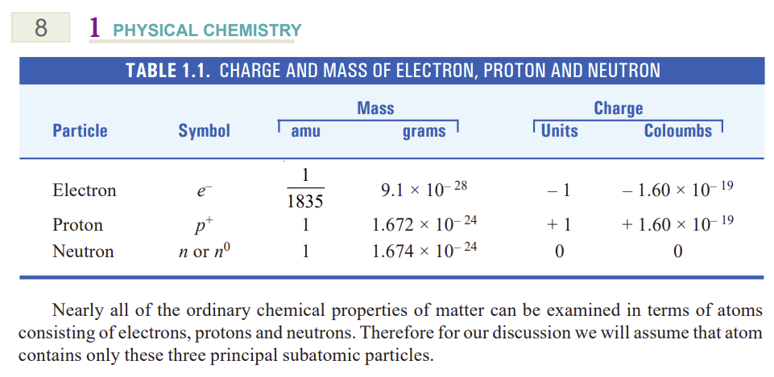

Slide 16
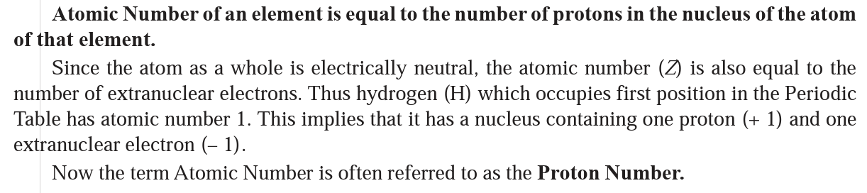
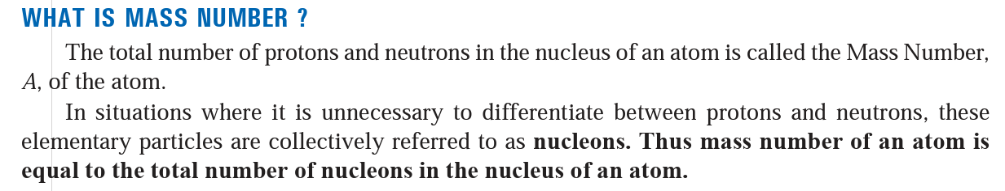

Slide 17
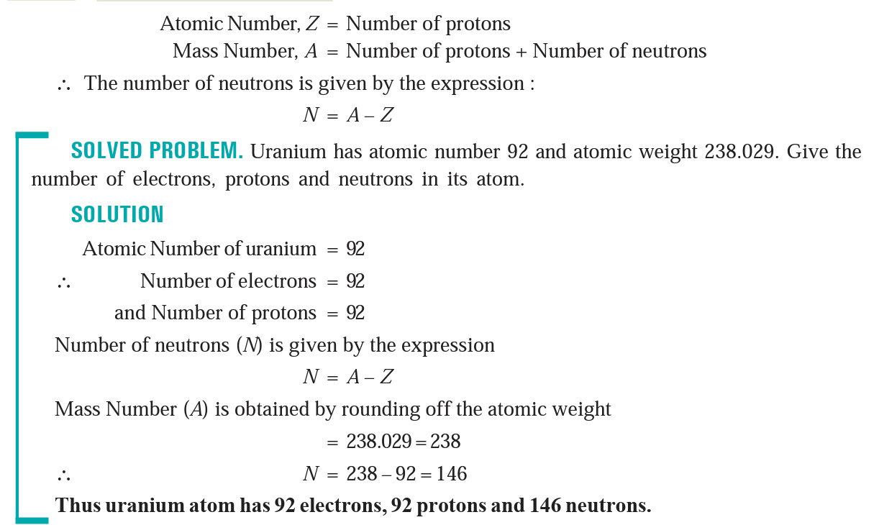

Slide 18
Write Rutherford’s experiment of scattering of α-particles and give the drawbacks of atomic model.
Calculate the number of molecules in 4.4 g of CO₂.

Slide 19
History of the development of Chemistry
In 1803, Dalton proposed his atomic theory and explained the laws of chemical combination with the help of this theory.
The law of combining volumes for gaseous reactions was established by Gay-Lusac in 1808, and to explain this, Avogadro proposed his hypothesis and the concept of molecules in 1811, which subsequently became Avogadro’s law.
The systematic study of chemistry progressed faster during the nineteenth century. Relative atomic masses were determined using chemical reactions, new elements were discovered, attempts were made to systematize properties of elements, the periodic table was developed (Mendeleev, 1869).

Slide 20
History of the development of Chemistry
A systematic study of energy changes in physical and chemical changes during the nineteenth century led to the establishment of a branch of science known as thermodynamics
1860s: James Clark Maxwell: light as waves of vibrating electric and magnetic fields
Towards the end of the nineteenth century, a number of discoveries in Physics and Chemistry were made which rocked the foundation of natural science established earlier. Some of them are described below:
The spectrum of atomic hydrogen: Balmer, 1885, not continuous, but discrete lines;
Photoelectric effect; Hertz, 1887: electric current produced when light shines on certain metals

Slide 21
History of the development of Chemistry
X-rays : Roentgen, 1895, a barium platinocyanide screen, inadvertently lying near a cathode-ray tube covered in a cardboard box emitted fluorescent light. high frequency radiation emitted by metals when bombarded with electrons
Radioactivity: Antoine Henri Becquerel(1896): he observed that the element uranium can blacken a photographic plate, although separated from it by glass or black paper.
Discovery of electron: Thomson 1897. cathode rays found to consist of stream of particles with negative charges, independent of the material used. Plum-pudding model of atom (1898).

Slide 22
History of the development of Chemistry
Explanation of all these newly observed results was not possible with the help of classical theories based on Newtonian mechanics.
In 1901, a revolutionary theory was proposed by Max Planck.
He proposed: radiation is emitted in discrete units of energy, called quanta.
No scientist was ready to accept this idea.
But in 1905, Einstein applied it and gave a satisfactory explanation of photoelectric effect.

Slide 23
History of the development of Chemistry
1909: Rutherford and his colleagues measured the scattering of α-particles and discovered the nucleus.
1911: Rutherford’s nuclear model of the atom.
1913: Bohr model of the atom. Bohr applied the ideas of Max Planck and gave a satisfactory explanation of the atomic spectrum of hydrogen.

Slide 24
History of the development of Chemistry
1913: Mosley: linear relation between the order of atomic masses and the square root of the frequency of X-rays emitted by the element upon bombardment by electrons: the concept of atomic number.
1913 Thomson: the concept of isotopes from the behavior of positive rays.
1916: Lewis: covalent bonding. Octet electron configuration attainment as the driving force for bond formation.
1919: Aston: mass spectrograph and the discovery of the proton. Determination of its charge.

Slide 25
History of the development of Chemistry
1923: Compton: light can change the path of an electron.
1925: Louis de Broglie: both particle and wave (dual) nature of matter.
1927: Davisson and Germer: diffraction of electrons by nickel crystal; dual nature of electrons.
1927: Heisenberg, Schroedinger: Quantum mechanics to calculate properties of microscopic systems.
1928: Discovery of Raman effect.

Slide 26
History of the development of Chemistry
1930s and 1940s: Application of quantum mechanics and calculation of translational, rotational, vibrational, and electronic energies of microscopic particles. Quantum transition by absorption of electromagnetic radiation; development of electronic, vibrational, and rotational spectroscopy of molecules.

